Slide 1
Recreate and Extend
REDCap + R Workshop
REDCapCon 2023

Slide 2
Your Turn
This final exercise is a group activity.
Break into 5 groups and complete 00_recreate_extend.qmd together.
After the exercise, each group will present their findings (1 min each).

Slide 3
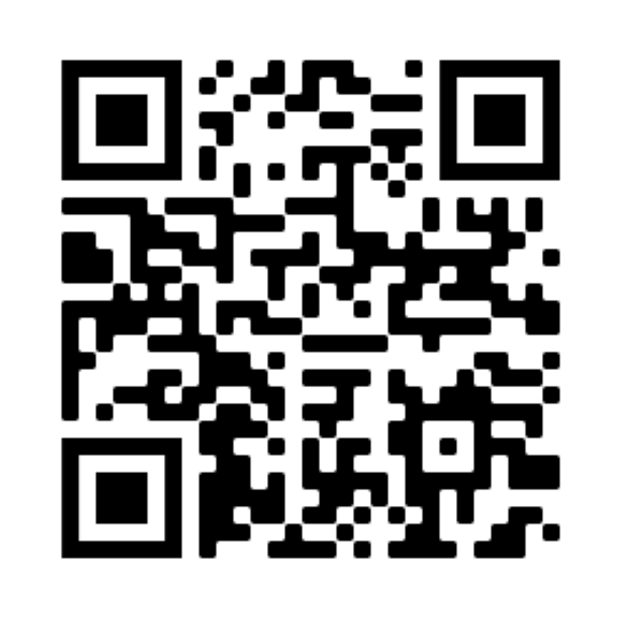
Thank You!
Please fill out this eval!
Notes:
Survey URL:
https://redcap.chop.edu/surveys/?s=XFYLDTNJF983TH89
Pick “Stephan Kadauke” and write “REDCap+R Workshop” for session title.

